Slide 1

Teleoperated Driving
Final Presentation
AUF/ IAE Group Project
WS2021

Slide 2
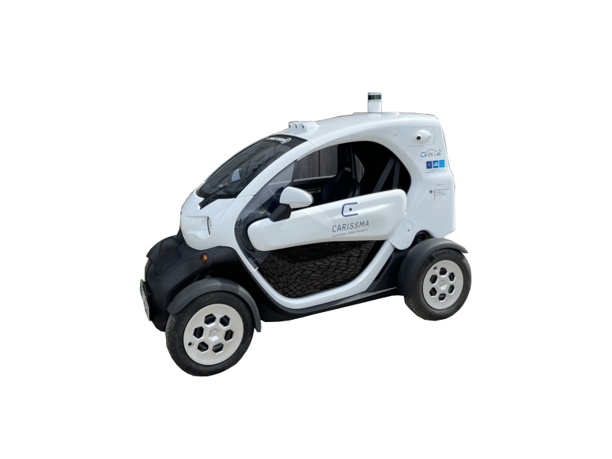
Outline
Steps towards the final system
Control
Communication
Video

Slide 3
Control
Main Target
The control of the vehicle should be interactive and easy to operate by using Joystick.
Implementation of source code with the help of Python and ROS environment.
Developing a publisher node for publishing specific type ROS message (i.e. Input Commands from Joystick) over a given ROS topic.
To achieve real-time control commands for transmission.

Slide 4
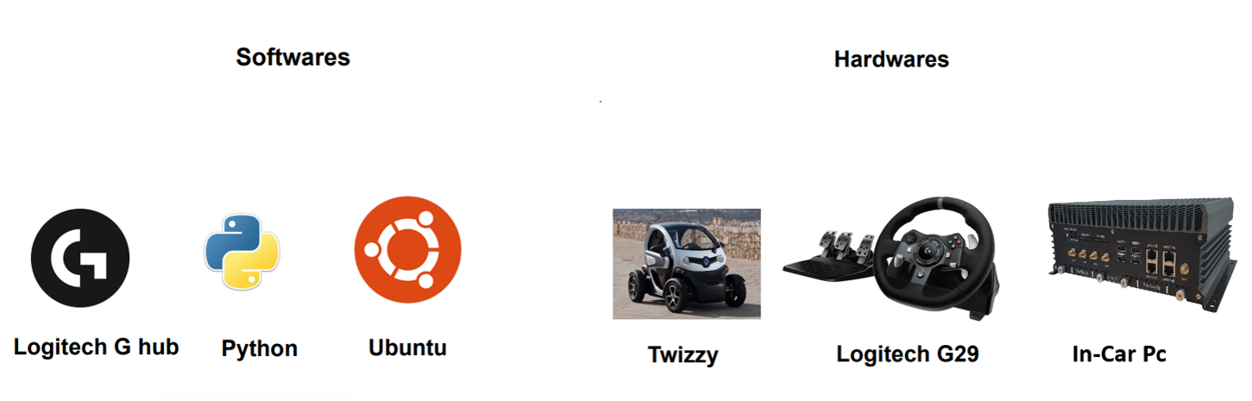

Control
Hardware and Software overview

Slide 5
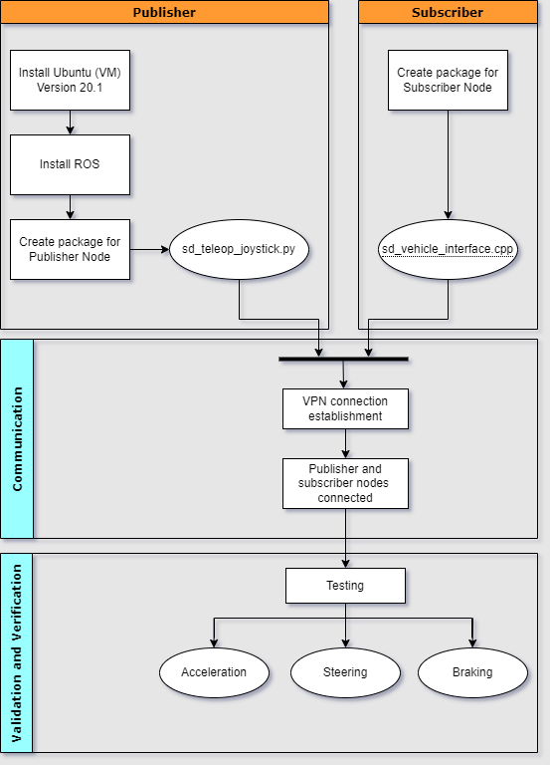
Control
System Setup

Slide 6
Control
Challenges Faced
Issues while collecting raw data from joystick
Problems while setting maximum Steering angle value of vehicle
Problems while developing and implementing of publisher node
Errors while multiple inputs are given i.e acceleration and braking
Difficulty with steering wheel as it was not able to return to initial position.
The transmission of the control commands should be in real-time.

Slide 7
Control
Future Scope
For better driving and safety purpose we can add more functions in control
Parallel use of different technology with data fusion wireless, radar systems of different ranges, laser scanners, image processing systems.

Slide 8
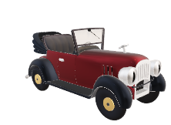
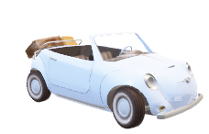
Video
Timeline
Teleoperated Driving - Timeline
07.10.2021
21.10.2021
INSTALLATION and TESTING OF REQUIRED PYHTON LIBRARIES IN LAB PC. (ZOTAC)
11.11.2021
25.11.2021
17.12.2021
05.01.2021
13.01.2022
Fallback plans and final Demonstration along with presentation
INTEGRATION DAY
Testing and Development
PROJECT START
INTRODUCTION OF PROJECT
FAMILARISING WITH ROS, G-STREAMER AND LINUX
EASYPYSPIN
OPENCV
G-STREAMER
Working on GUI-TkInter
Creating a realistic view according to drivers perspective using 3 screens.
Streaming 1 video over Wi-fi network
Testing the scripts for sending video and receiving from Twizzy to GUI over VPN
Decrease the video lag in GUI.
Transmission of Video through VPN from single camera into GUI

Slide 9
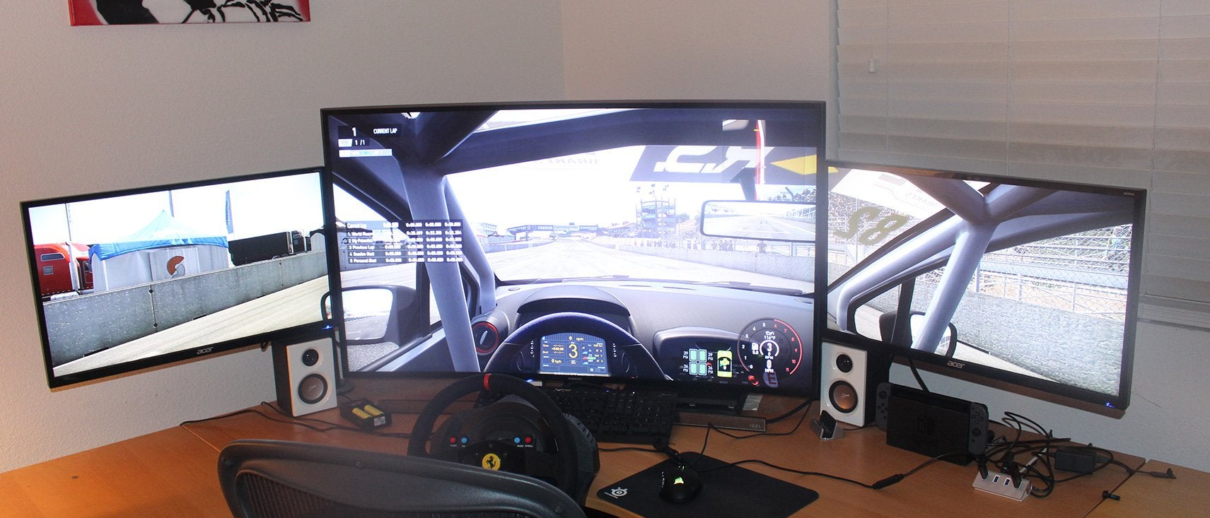
Video
Objective

Slide 10
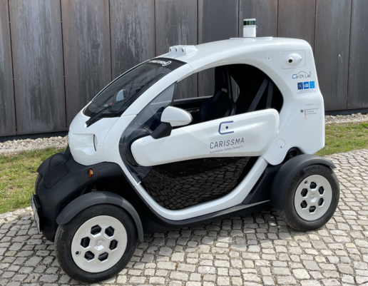
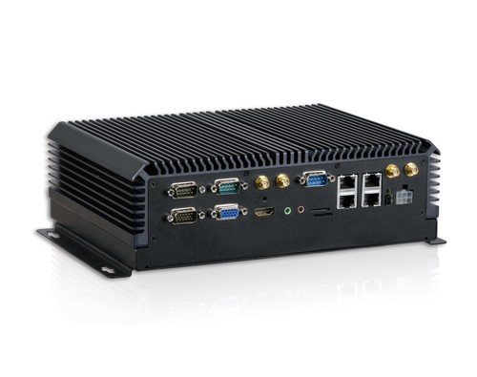
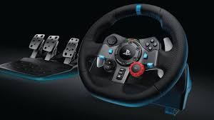
Video
Hardware Components
Cameras from Renault Twizy-Street Drone
In-Car PC
Logitech PS Joystick

Slide 11




Video
Software Components
EasyPySpin
Ease and comfortable tool to capture multiple images.
OpenCV
Reading and Send video via g-streamer
G-streamer
Creating pipeline between sender and receiver
Tkinter
Visualize images from Twizy and joystick data

Slide 12
Video
Challenges
Video transmission Lag in GUI
Complexity with Fish-Eye effect
Grayscale images received from Twizy

Slide 13
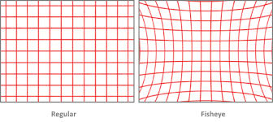
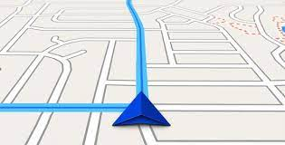
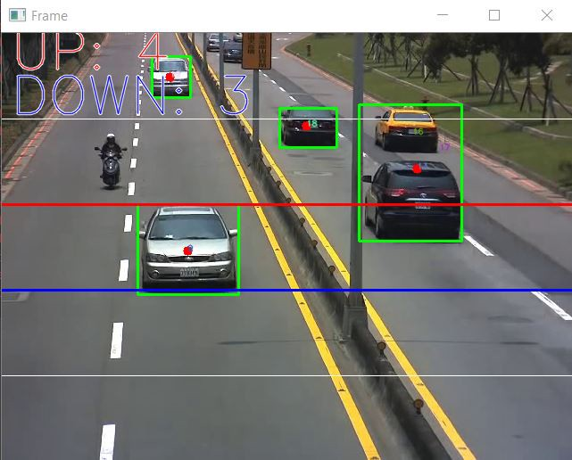
Video
Future Scope
Removal of Fish Eye effect.
Display Navigation system in GUI for real time location.
Object Detection
Can be used to identify other Collision object (Pedestrian, Other vehicles and trucks, motorcycle )
Data from Twizzy could be extracted for real time parameters. (Velocity, Steering angle)

Slide 14
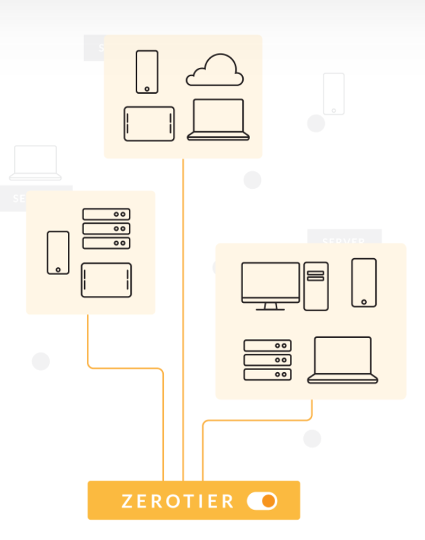
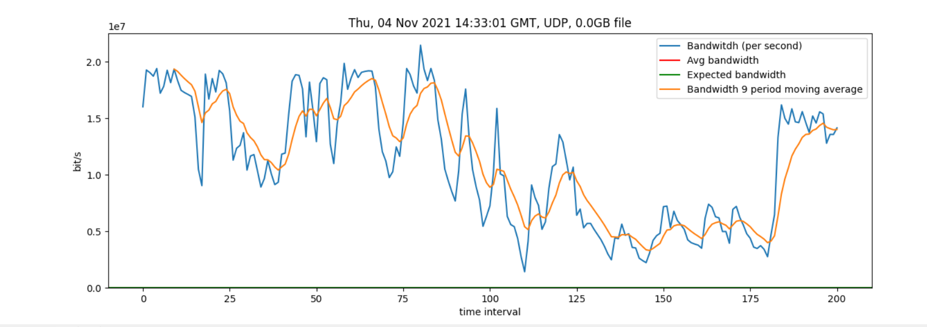
Communication
Control(Joystick)
192.168.196.xx
VPN Networking
Zerotier Combines the capabilities of VPN and SD-WAN, simplifying the network management with 256-bit encryption.
Video streaming using UPD traffic
Control messages using TCP traffic.
Operator PC
192.168.196.xx
Twizy PC
192.168.196.xx
Network performance curve
Network ID 17d709436cba3435

Slide 15
Communication
Control Communication
ROS environment establishment for control communication .
publisher and subscriber nodes to realize the seamless delivery of control messages to twizy
Zerotier(IPV4 protocol) VPN network establishment between publisher receiver nodes in order
to enhance the driving range.
ROS
Master
ROS
Slave
ROS publisher node
VPN Network
ROS Subscriber node
Interface from ROS to CAN
Joystick input
CAN Frames to twizy

Slide 16
Communication
Video Communication
Video streaming from twizy(source) to operator PC(sink) over VPN network and VPN port which uses the
OSI application layer.
Streamed packets are routed using UPD protocol datagrams
Gstreamer pipelines are addressed using VPN Internet protocols, which specifies the host address field.
UDP packets are preferred, so that the latency of the packets are less in comparison to TCP
UPD Datagrams
Twizy PC
VPN port
Twizy Cameras
Operator PC

Slide 17
Communication
Challenges
Network instability
Weak performance of VPN network for UDP packets of Video frames
Publishing the ROS messages over VPN that realizes network between cellular and ethernet/wifi
Performance of the network depends on the network speed of the source connection.
Communication establishment between sender and receiver time is varied from network to network.

Slide 18
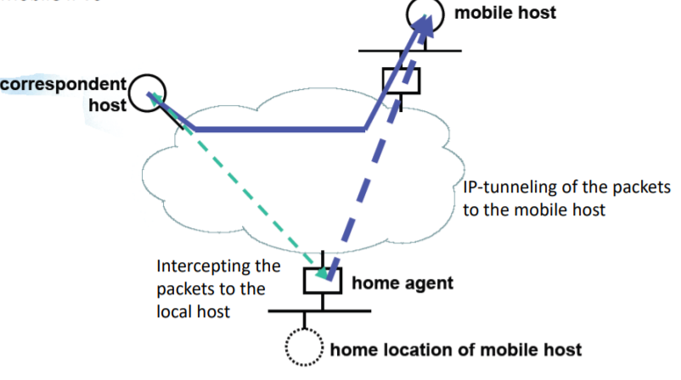
Communication
Future Scope
VPN establishment using other providers like husarnet or openvpn. Husarnet VPN is specifically designed
for ROS environment and it uses IPV6 protocol
VPN network with Mobile IPV6 protocol.
Mobile IP is a standard communication protocol that is designed to allow mobile device users to move
from one network to another while maintaining a permanent IP address.
Mobile IPV6

Slide 19

Lessons learned
It’s not always the obvious solution
It doesn’t have to make sense to work
You’re not the first and only one facing an issue
→ Ask Google
Most difficult part: matching different schedules
Communication is the key
First integration attempt will ALWAYS fail
Murphy’s law is in fact true
Always prepare a plan B for you plan B

Slide 20
If we could restart, what would we do differently?
Create project plan beforehand, incl. fixed time
slots with the Twizy
Start directly with working on last semester’s
code → Learning by doing

Slide 21
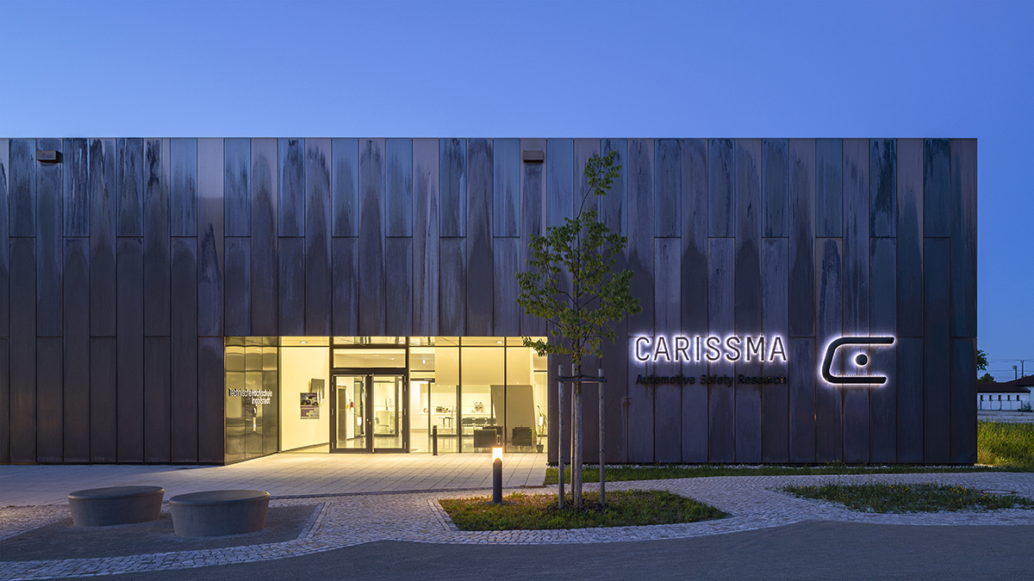
Thank you for your attention! Any questions?

